Slide 1
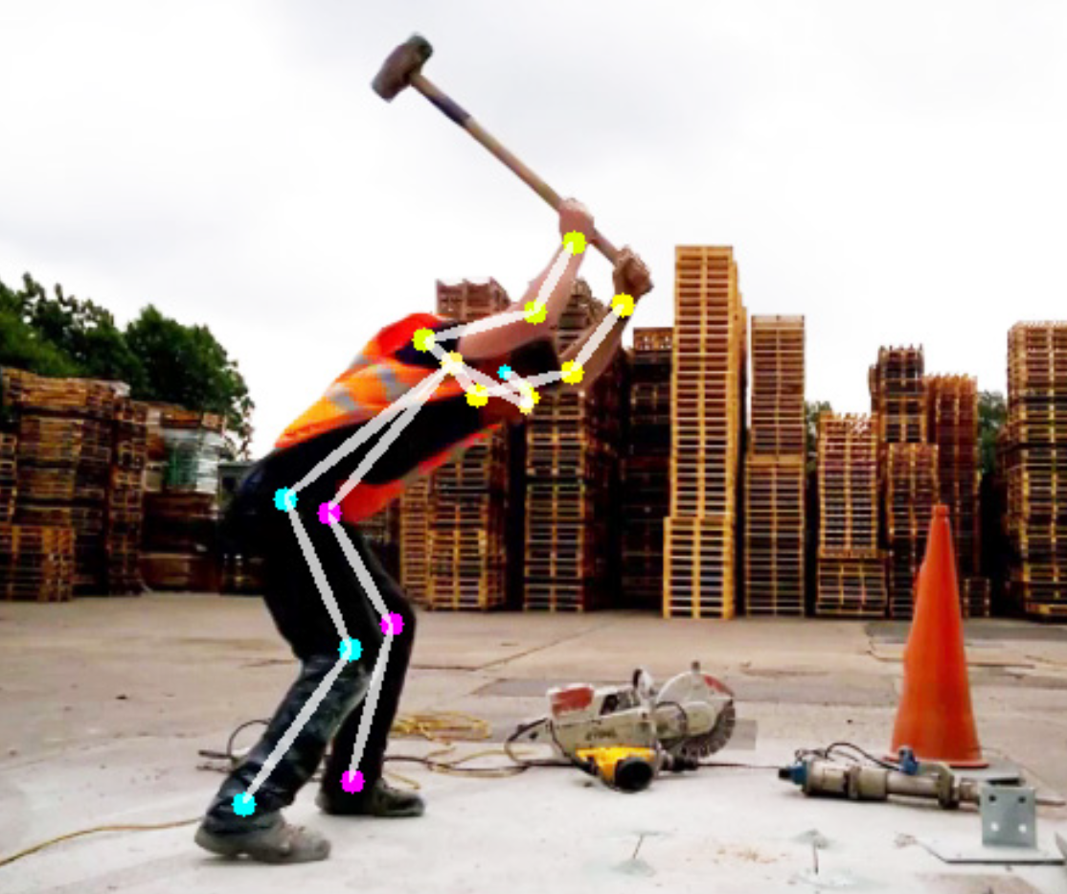
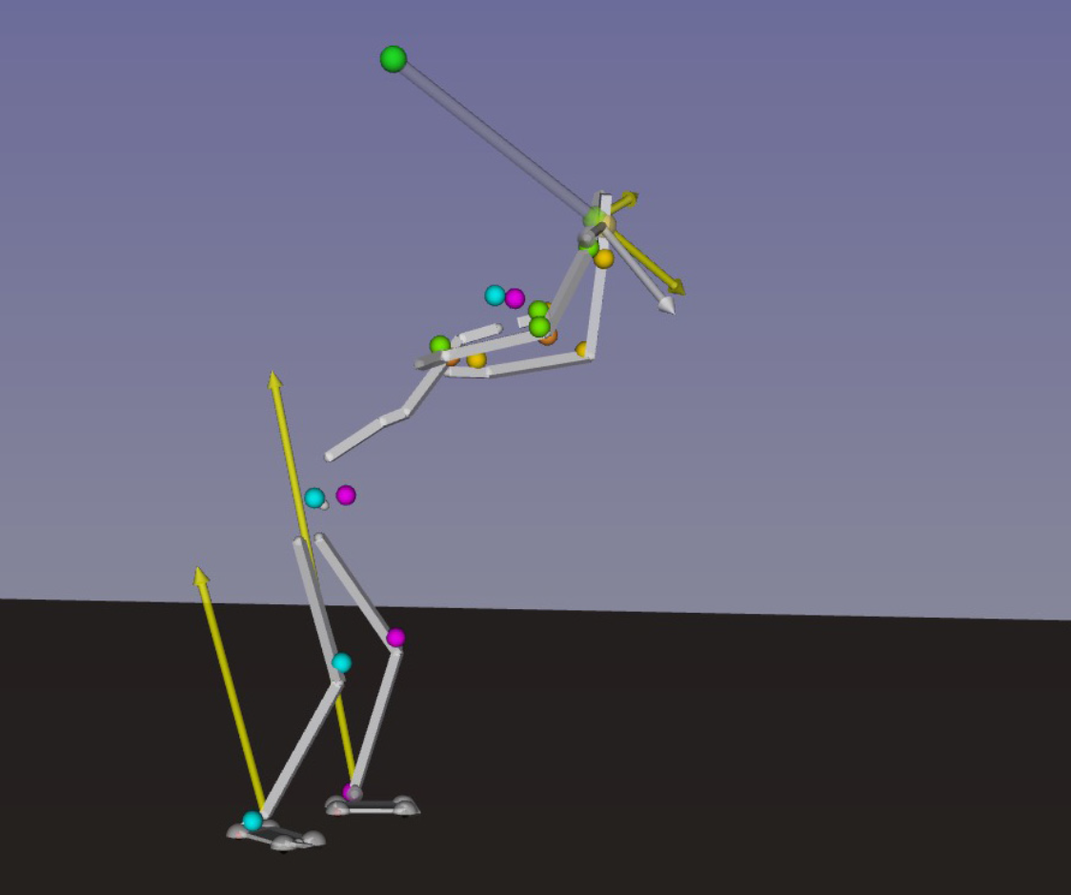



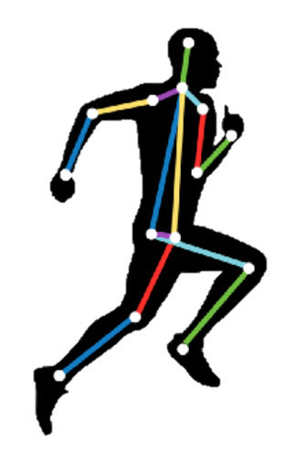


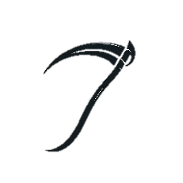
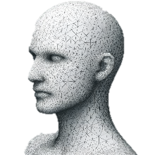


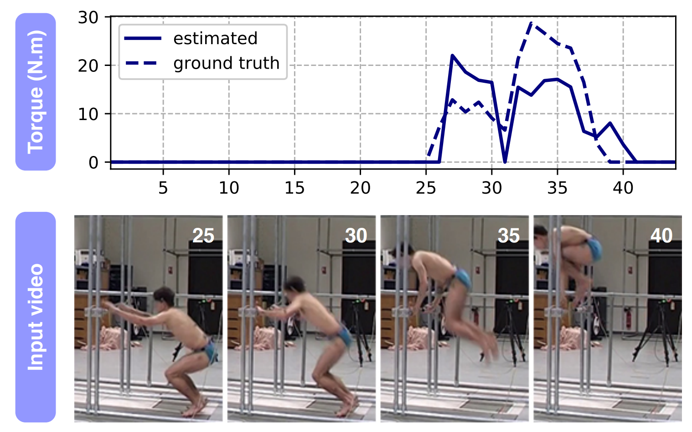
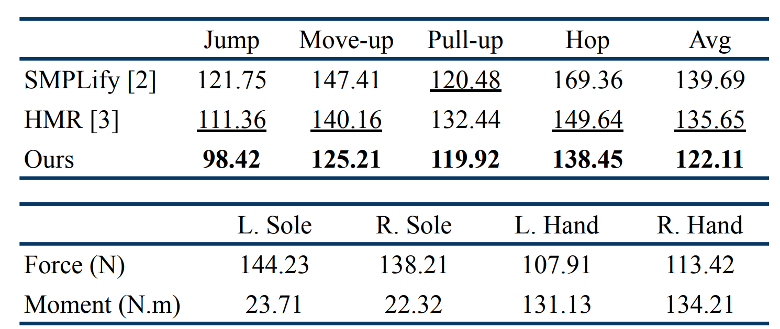
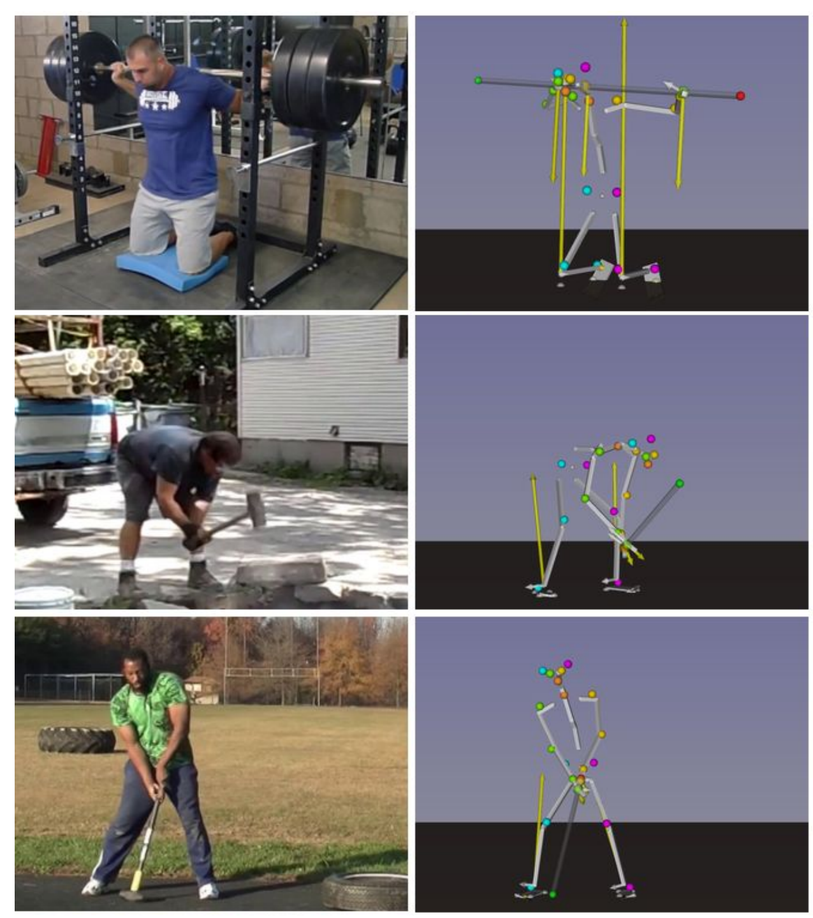
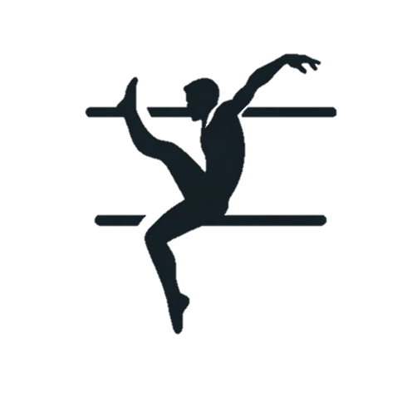

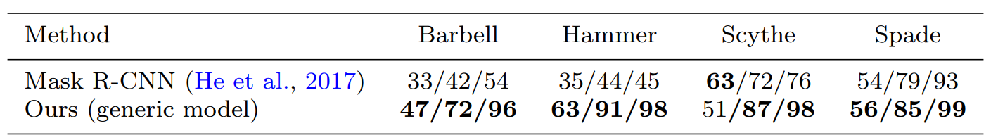


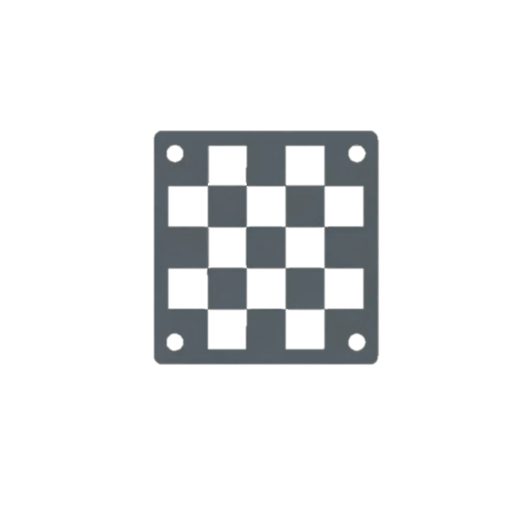

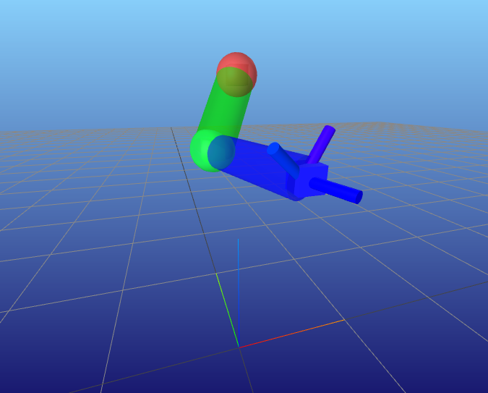

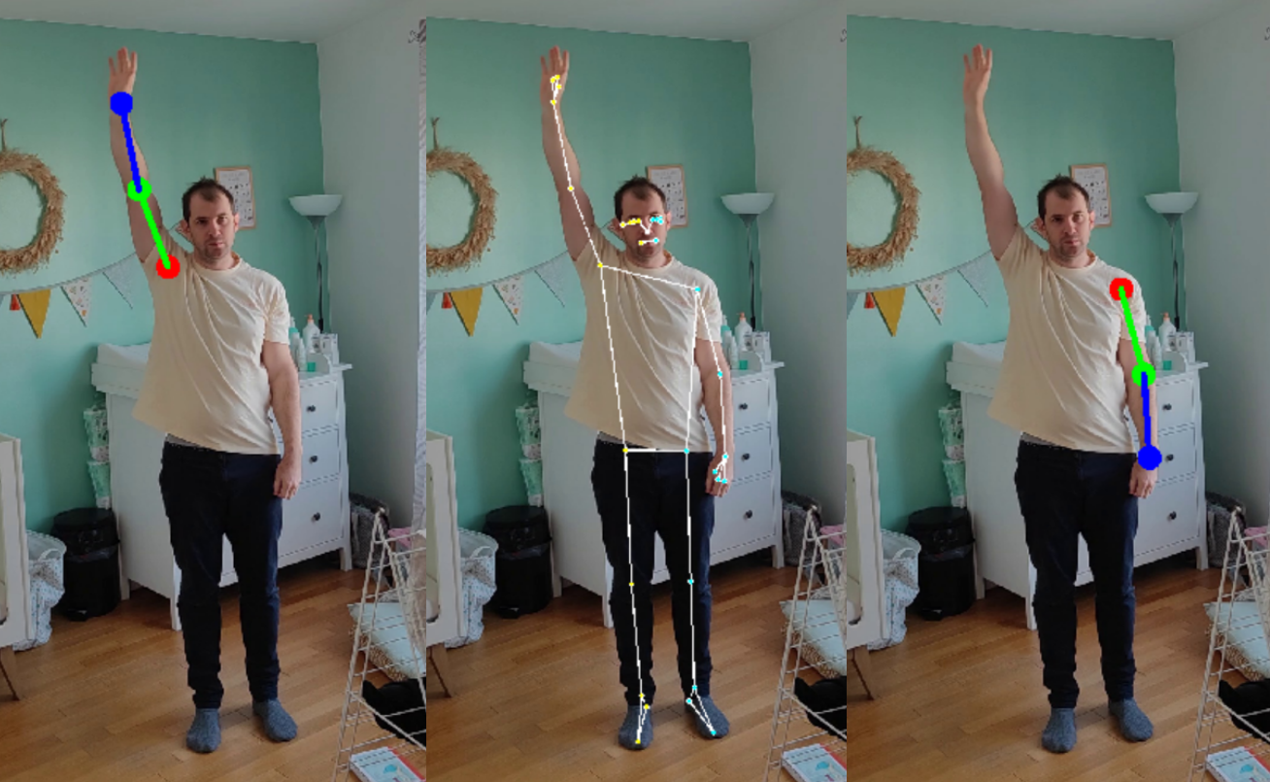
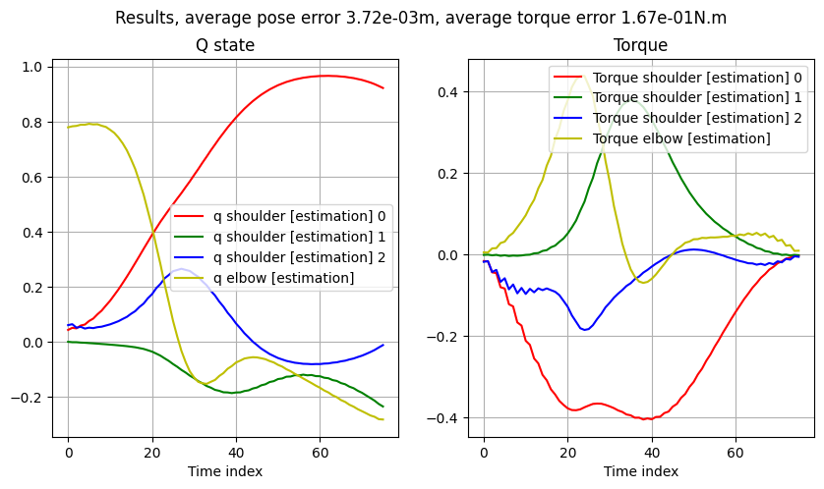
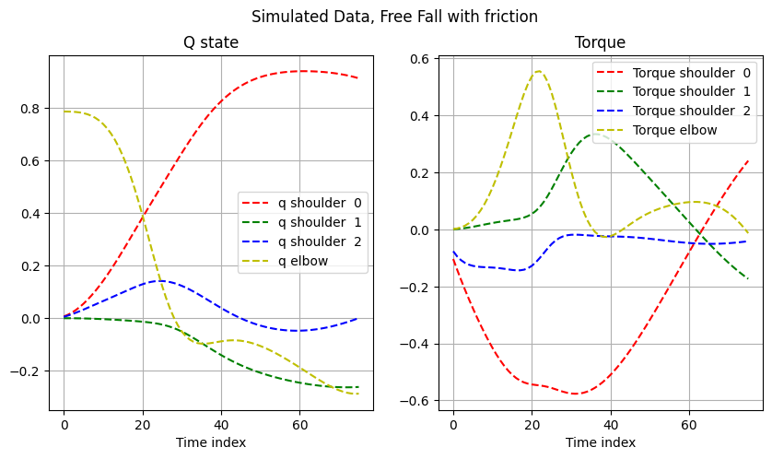
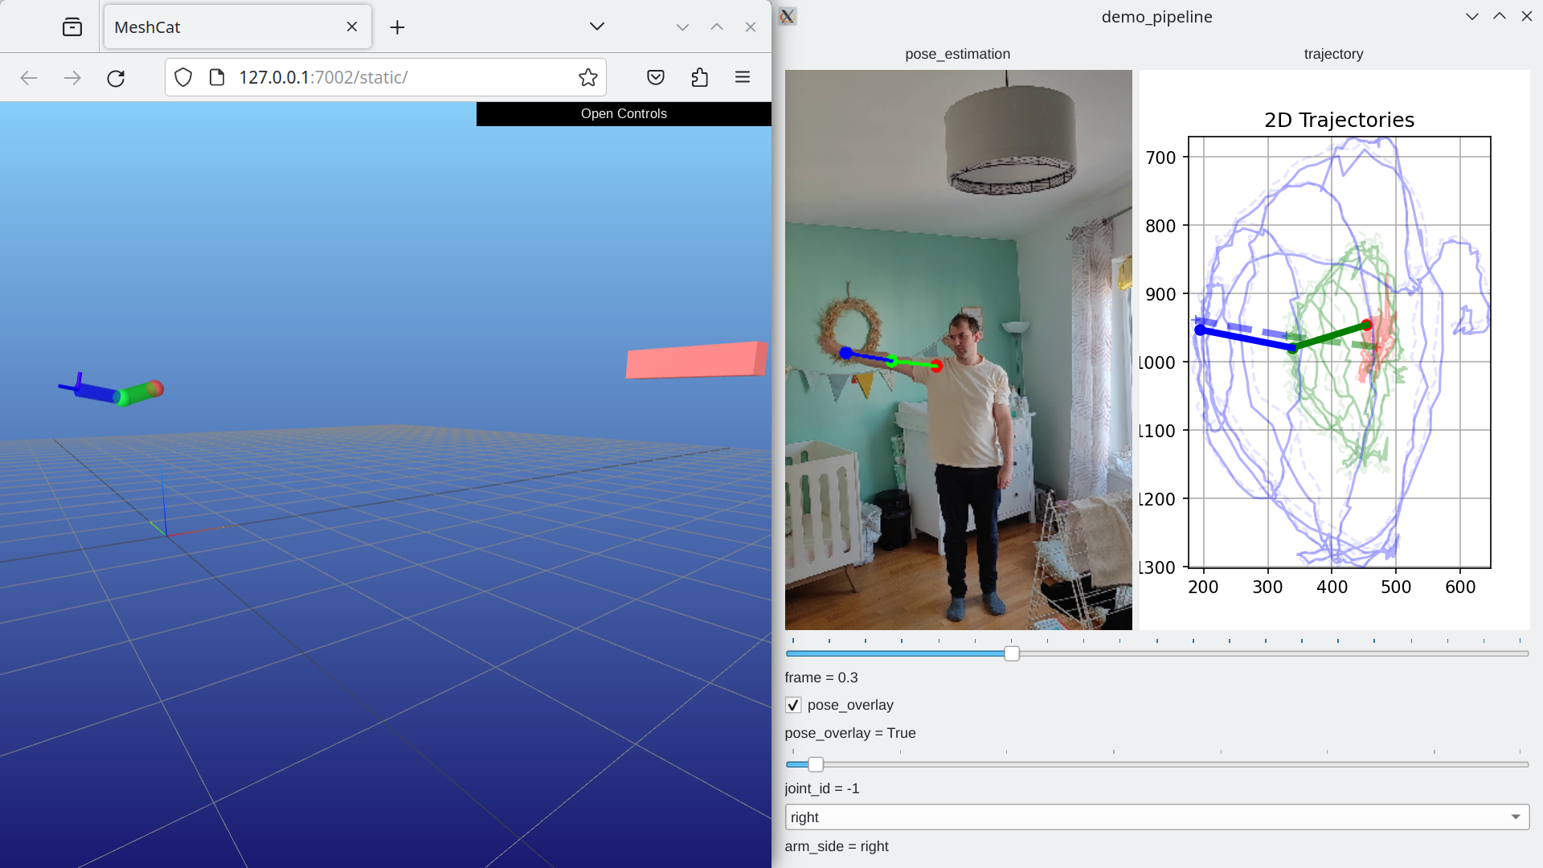
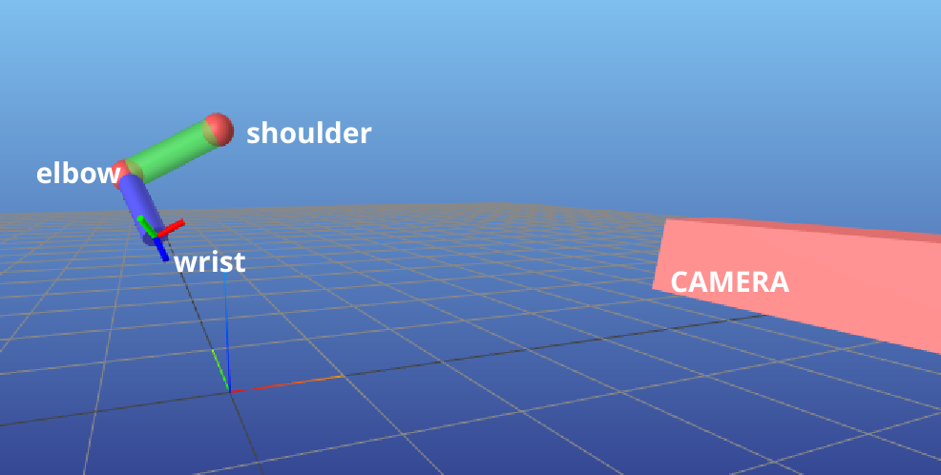
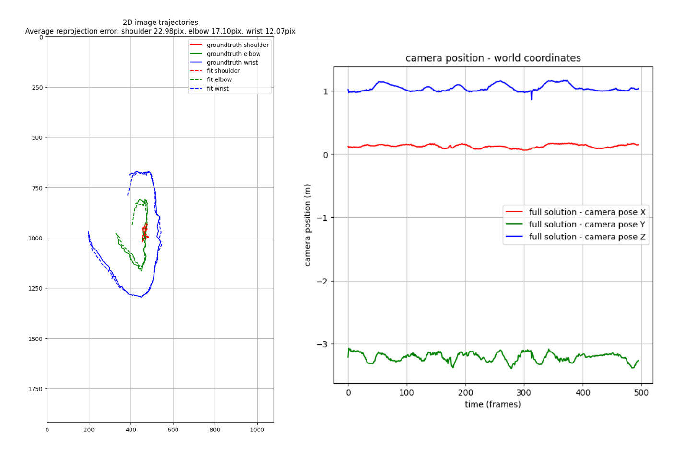
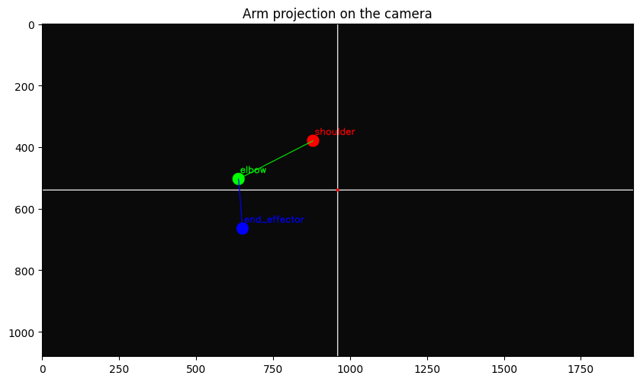
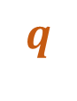


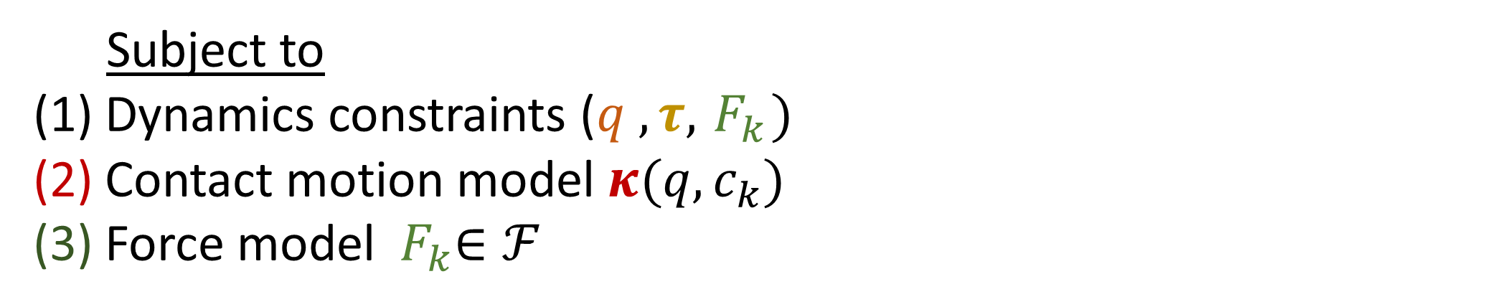

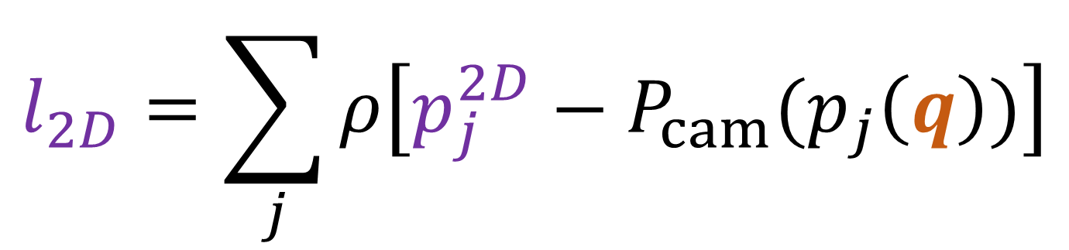
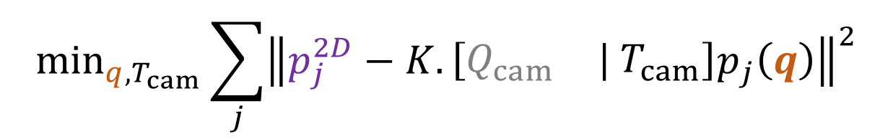
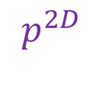
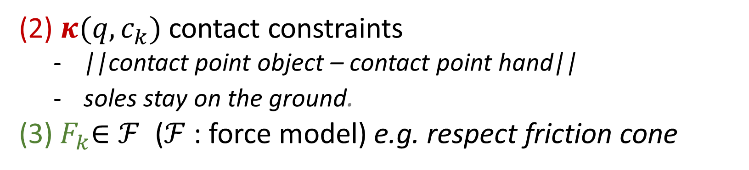
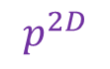
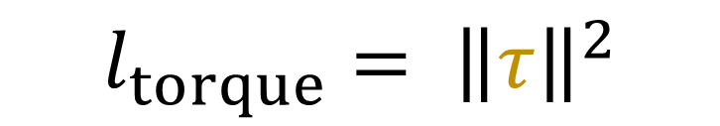
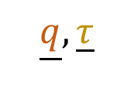
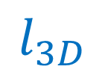

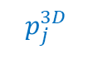
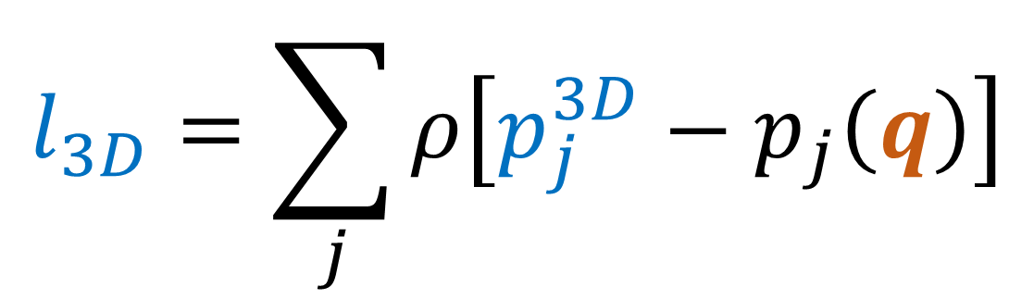



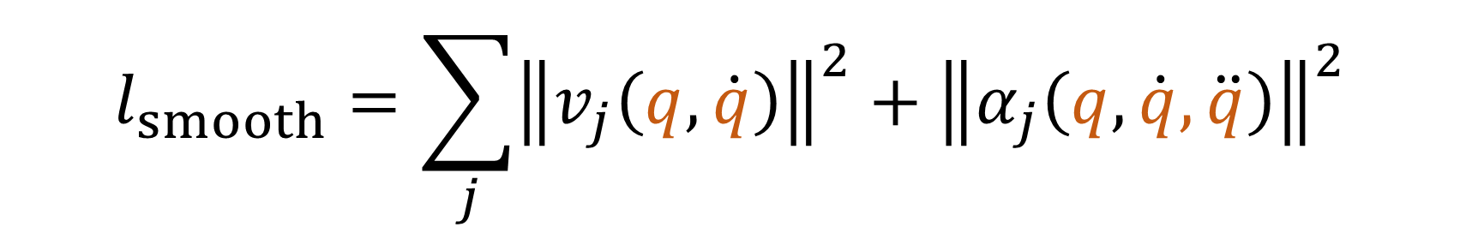

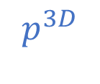

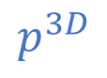
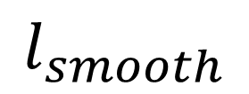

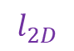
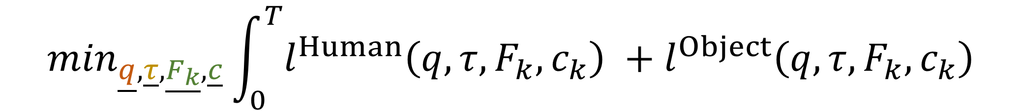
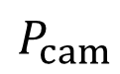
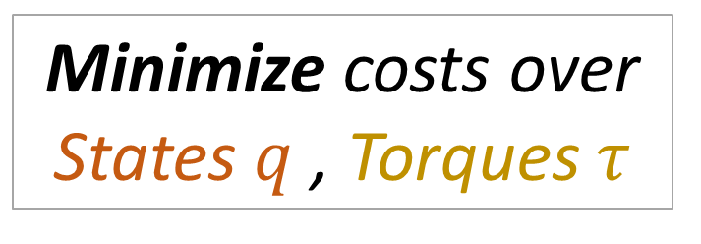
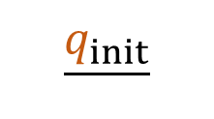
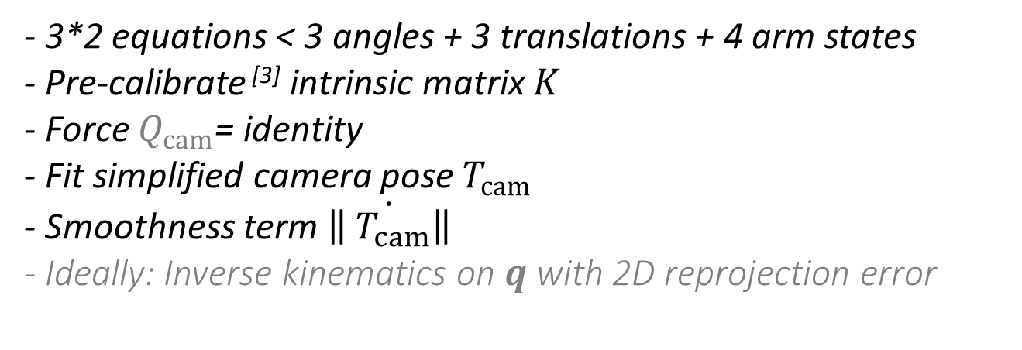

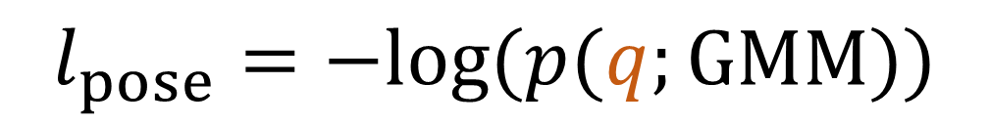
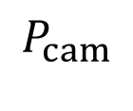

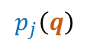
Estimating 3D Motion and Forces of Person-Object
Interactions from Monocular Video
Reviewed by Matthieu Dinot, Balthazar Neveu
Goal : reconstruct a digital twin of a human
without a motion capture system
from non-stereo videos in the wild
3D body motion
body torques
contact forces
→ in order to do behavior cloning on robots
$$p^{3D}$$
Optimizer
Inverse dynamics
$$q$$
$$κ_{k}$$
POSE ESTIMATION
DIGITAL TWIN
$$p^{2D}$$
$$τ$$
$$F_{k}$$
Estimating 3D Motion and Forces of Person-Object Interactions from Monocular Video
Zongmian Li, Jiri Sedlar, Justin Carpentier, Ivan Laptev, Nicolas Mansard and Josef Sivic
$$P_{cam}$$
System overview
CONTACT
DETECTION
ResNet
2D POSE
ESTIMATION
OpenPose
RGB FRAMES
OBJECT DETECTION
Mask R-CNN
3D POSE ESTIMATION
HMR
$$\min_{\underline{q},\underline{τ},\underline{F_{k}}, \underline{c}}\int_{0}^{T}{l^{Human}\left(q,τ,F_{k},c_{k}\right) +l^{Object}\left(q,τ,F_{k},c_{k}\right)}$$
Minimize costs over
States, Torques , Forces,
Contacts , Camera pose
Subject to
(1) Dynamics constraints ($q , τ,{ F}_{k})$
(2) Contact motion model $κ(q,c_{k})$
(3) Force model ${ F}_{k}∈ℱ$
CONTACT POINTS
2D POSITIONS
OPTIMIZER
MASKS - BOUNDING BOXES
3D POSITIONS
Motion priors
Data fidelity
$$l_{smooth}=\sum_{j}{{\left\|v_{j}\left(q, \dot{q}\right)\right\|}^{2}+{\left\|α_{j}\left(q, \dot{q}, \ddot{q}\right)\right\|}^{2}}$$
(1) Lagrange dynamics constraints
Constraints
2D reprojection error
$$l_{2D}=\sum_{j}{ρ\left[p_{j}^{2D}−P_{cam}(p_{j}\left(q\right))\right]}$$
Linear velocity
Linear acceleration
$$M\left(q\right)\ddot{q}+b\left(q, \dot{q}\right)=g\left(q\right)+τ$$
3D forward kinematics error
$$l_{pose}=−log⁡(p(q;GMM))$$
(2) $κ(q,c_{k})$ contact constraints
||contact point object – contact point hand||
soles stay on the ground.
(3)${ F}_{k}∈ℱ$ ($ℱ$: force model) e.g. respect friction cone
$$l_{3D}=\sum_{j}{ρ\left[p_{j}^{3D}−p_{j}\left(q\right)\right]}$$
Negative log likelihood of the pose
$$l_{torque}= {\left\|τ\right\|}^{2}$$
Torque norm
Evaluation
Dynamics regularization improves
pose estimations
Results
Limitations
Parkour dataset
3D joints error
[mm]
- Confidence on the forces and torques estimation
- High complexity method and code.
- Tedious tuning of loss coefficients
- Novel and difficult benchmark
- no simulation, motion capture only
- Variability with tool weight and body dimensions
- Vision pipeline with multiple inter-dependencies.
Vicon / Force sensors
Novel task
External Forces [N]
Torques [N.m]
New manually annotated tool dataset
Correct
Object localization
[% in @25/50/100px]
[1] hard to maintain, high probability of bugs, weakly documented or unit tested [2] fine tuned on the parkour dataset ? [3] re-injecting the estimated poses and torques into a simulator [4] dependencies = 4 github projects
Simplifications
Arm model, No objects, Static calibrated camera
Optimizer
Minimize costs over
States $q$ , Torques $τ$
$$q$$
$$p^{3D}$$
$$P_{cam}$$
$$p^{2D}$$
$$τ$$
System Overview
$$l_{3D}$$
$$l_{smooth}$$
$$l_{torque}$$
Relaxed dynamics ^{[2]}
RGB FRAMES
$$\min_{\underline{q},\underline{τ} }\sum_{t}{\left[\sum_{j}{ρ\left[p_{j}^{3D}−p_{j}\left(q\right)\right]}+\sum_{j}{{\left\|v_{j}\left(q, \dot{q}\right)\right\|}^{2}+{\left\|α_{j}\left(q, \dot{q}, \ddot{q}\right)\right\|}^{2}}+{\left\|τ\right\|}^{2}+{\left\|M\left(q\right)\ddot{q}+b\left(q, \dot{q}\right)−g\left(q\right)−τ \right\|}^{2}\right]}$$
2D & 3D POSE
ESTIMATION
MediaPipe
Linear velocity
Linear acceleration
Simulation of arm in free fall with friction
3D POSITIONS
estimation
groundtruth
2D POSITIONS
OPTIMIZER
3D POSITIONS
INVERSE KINEMATICS
$$\underline{q_{init}}$$
INVERSE DYNAMICS
$$\underline{q},\underline{τ}$$
$$p_{j}^{3D}$$
Demo
$$T_{cam}$$
Camera pose estimation
Pose estimation overlay
Camera projection
$$p_{j}^{3D}$$
INVERSE
KINEMATICS
^{[1]}
$$q$$
FORWARD
KINEMATICS
$$p_{j}\left(q\right)$$
CAMERA
PROJECTION
$$\hat{p_{j}^{2D}}$$
$$l_{2D}$$
$$K$$
$$p_{j}^{2D}$$
Arm model
Camera
$$\min_{q{, T}_{cam}}\sum_{j}{{\left\|p_{j}^{2D}−K.\left[\begin{matrix}Q_{cam} & | T_{cam}\end{matrix}\right]p_{j}\left(q\right)\right\|}^{2}}$$
- 3*2 equations < 3 angles + 3 translations + 4 arm states
- Pre-calibrate ^{[3]} intrinsic matrix $K$
- Force $Q_{cam}$= identity
- Fit simplified camera pose $T_{cam}$
- Smoothness term $\dot{\left\|{ T}_{cam}\right\|}$
- Ideally: Inverse kinematics on $q$ with 2D reprojection error
Timeline slider
Synchronized digital twin
Python – Pinocchio – Meshcat visualization – Scipy solver – Interactive pipe – OpenCV – Mediapipe
[1] 3D arm lengths are standardized [2] $\dot{q}$ , $\ddot{q}$ estimated using finite differences [3] A Flexible New Technique for Camera Calibration, Zhengyou Zhang

